Slide 1
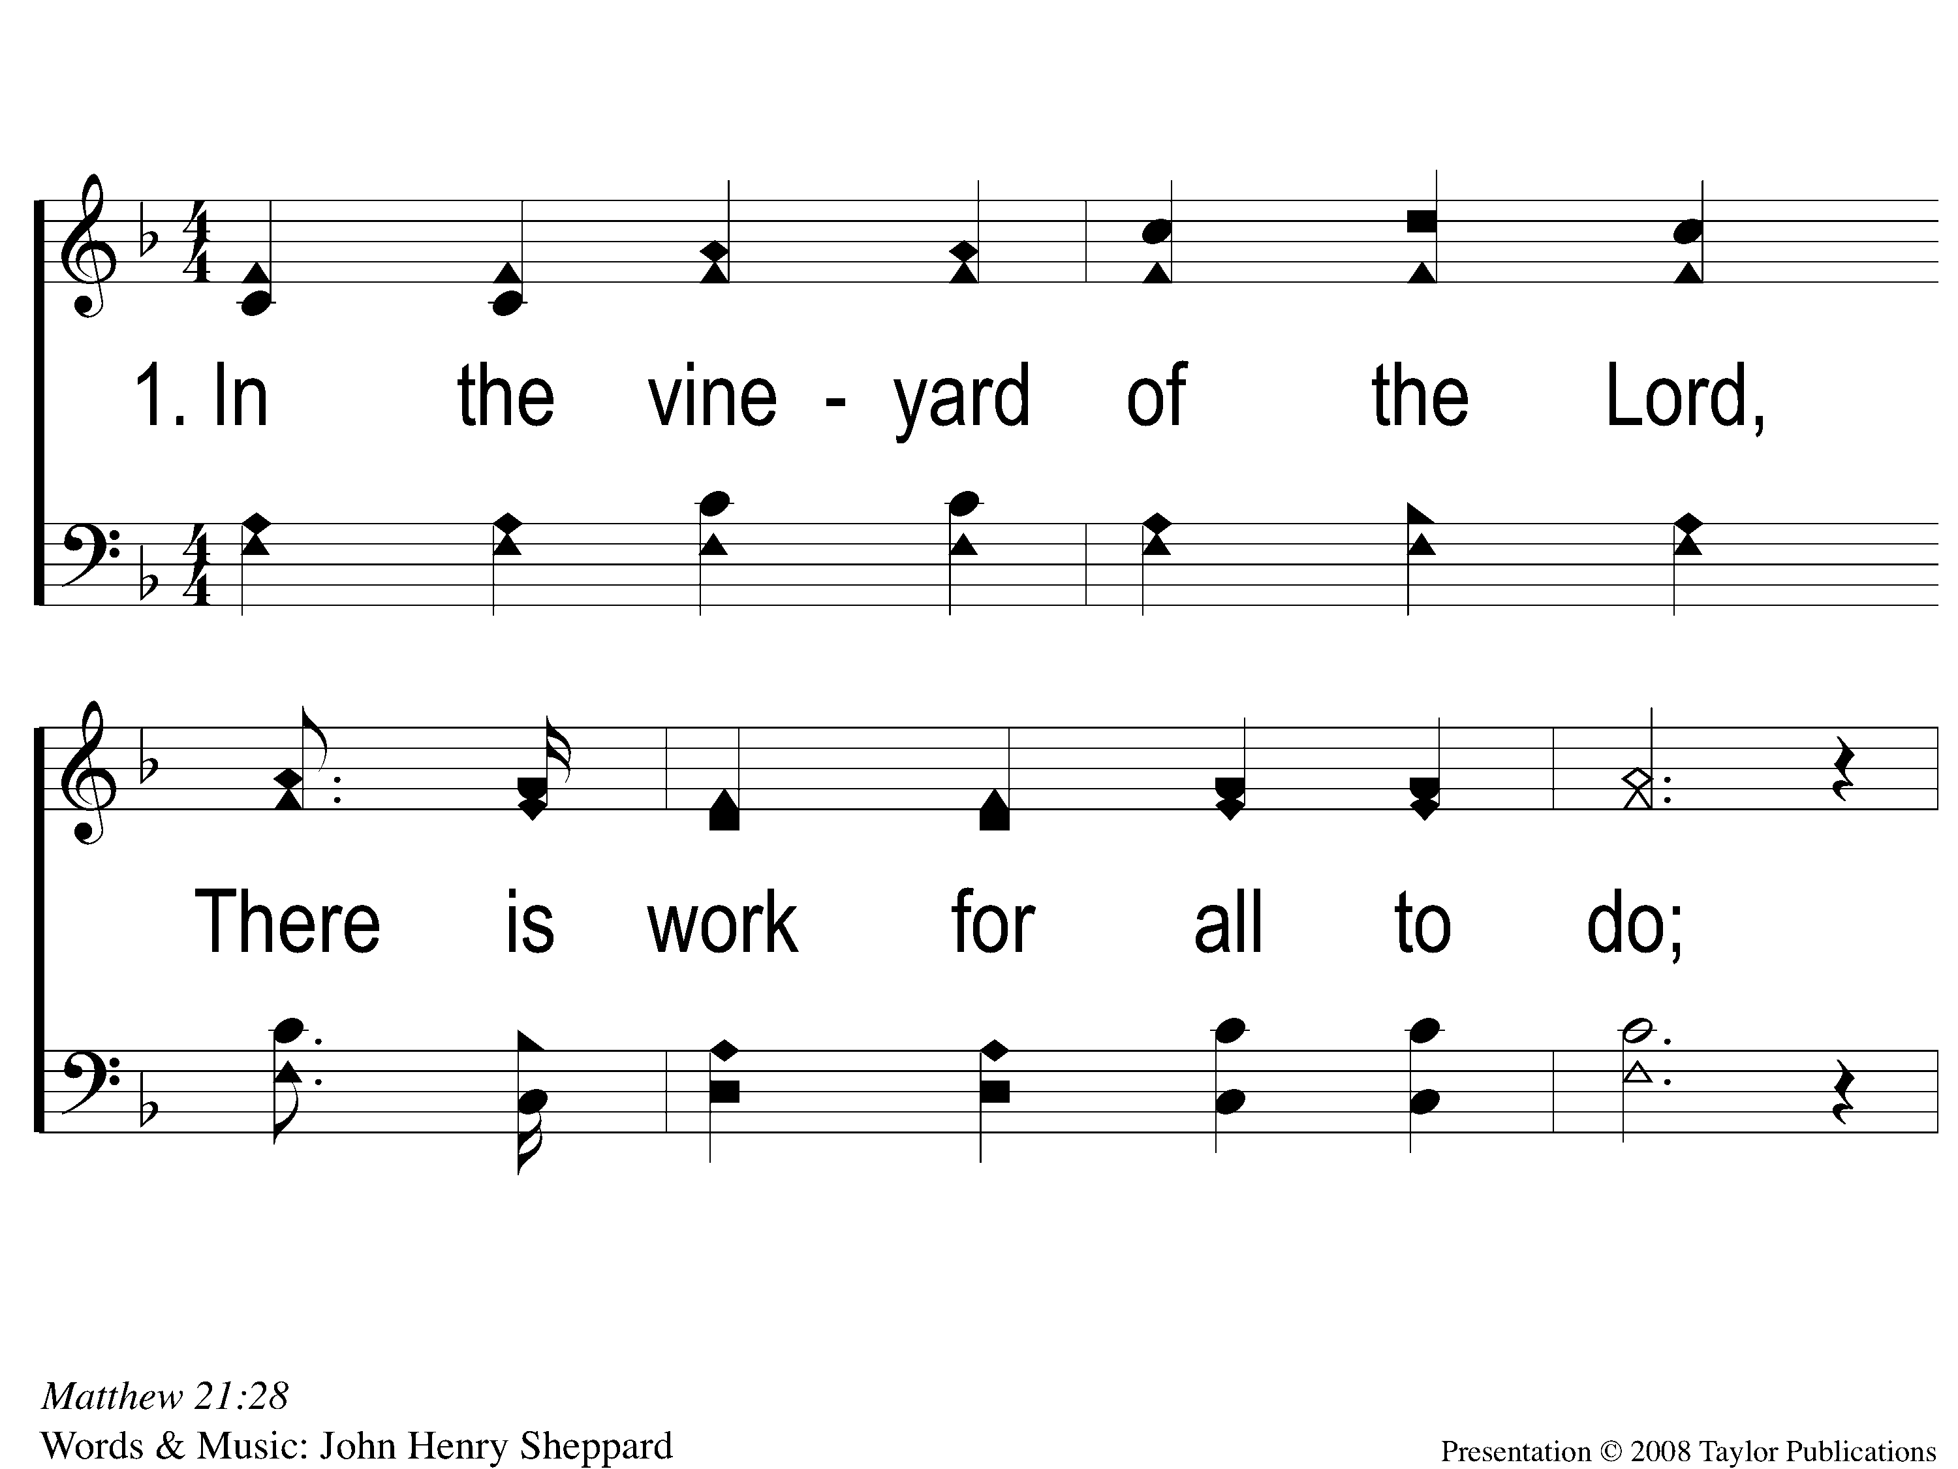
1-1 Call For Workers
Call For Workers
57

Slide 2
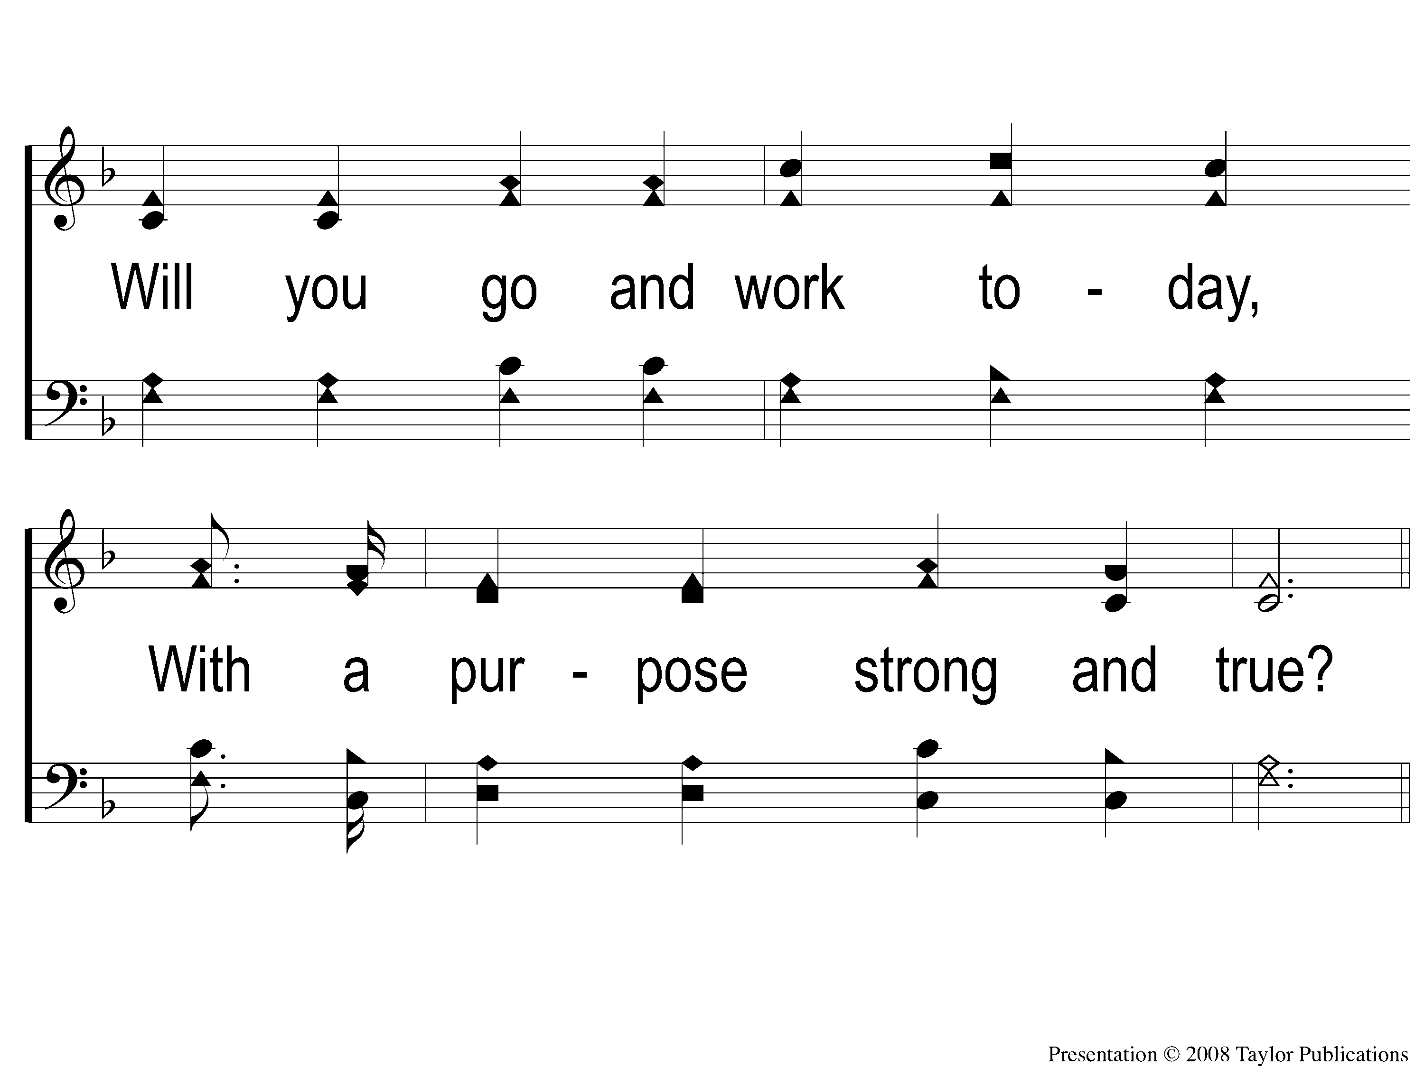
1-2 Call For Workers
Call For Workers
57

Slide 3
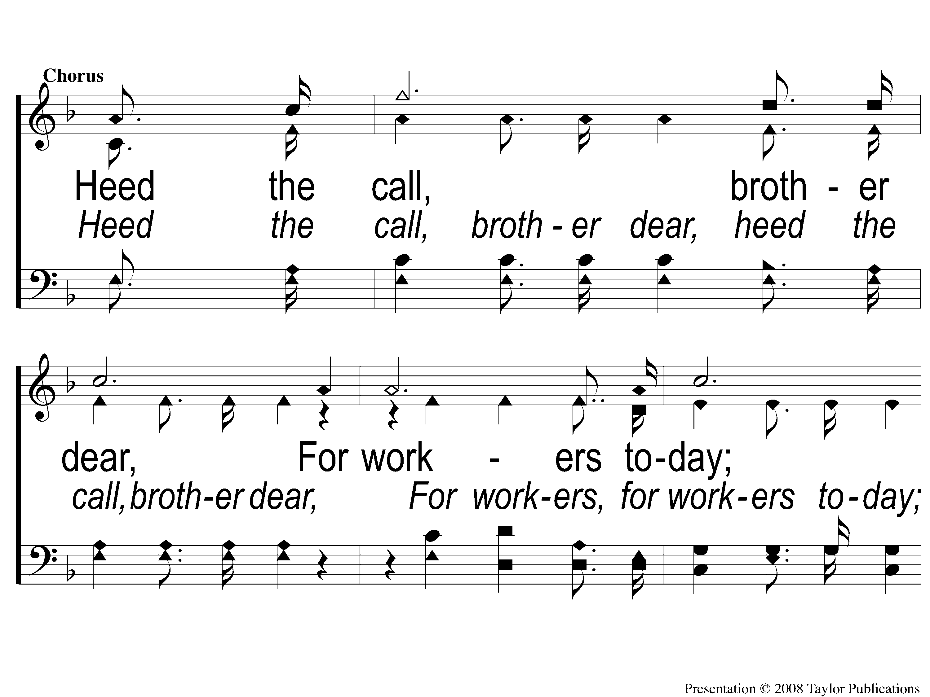
C-1 Call For Workers
Call For Workers
57

Slide 4
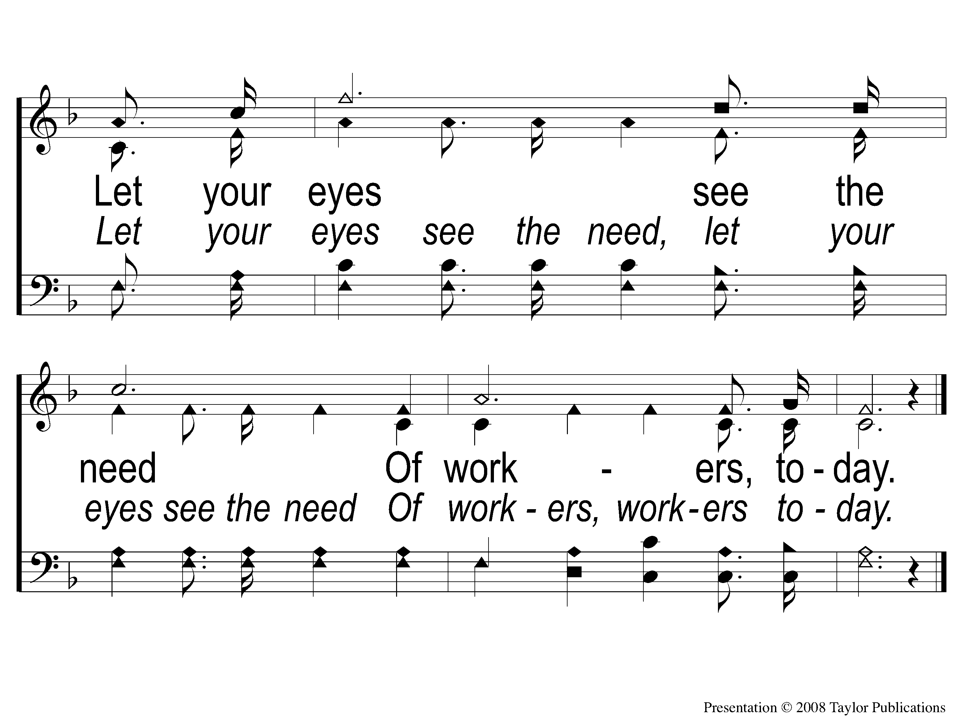
C-2 Call For Workers
Call For Workers
57

Slide 5
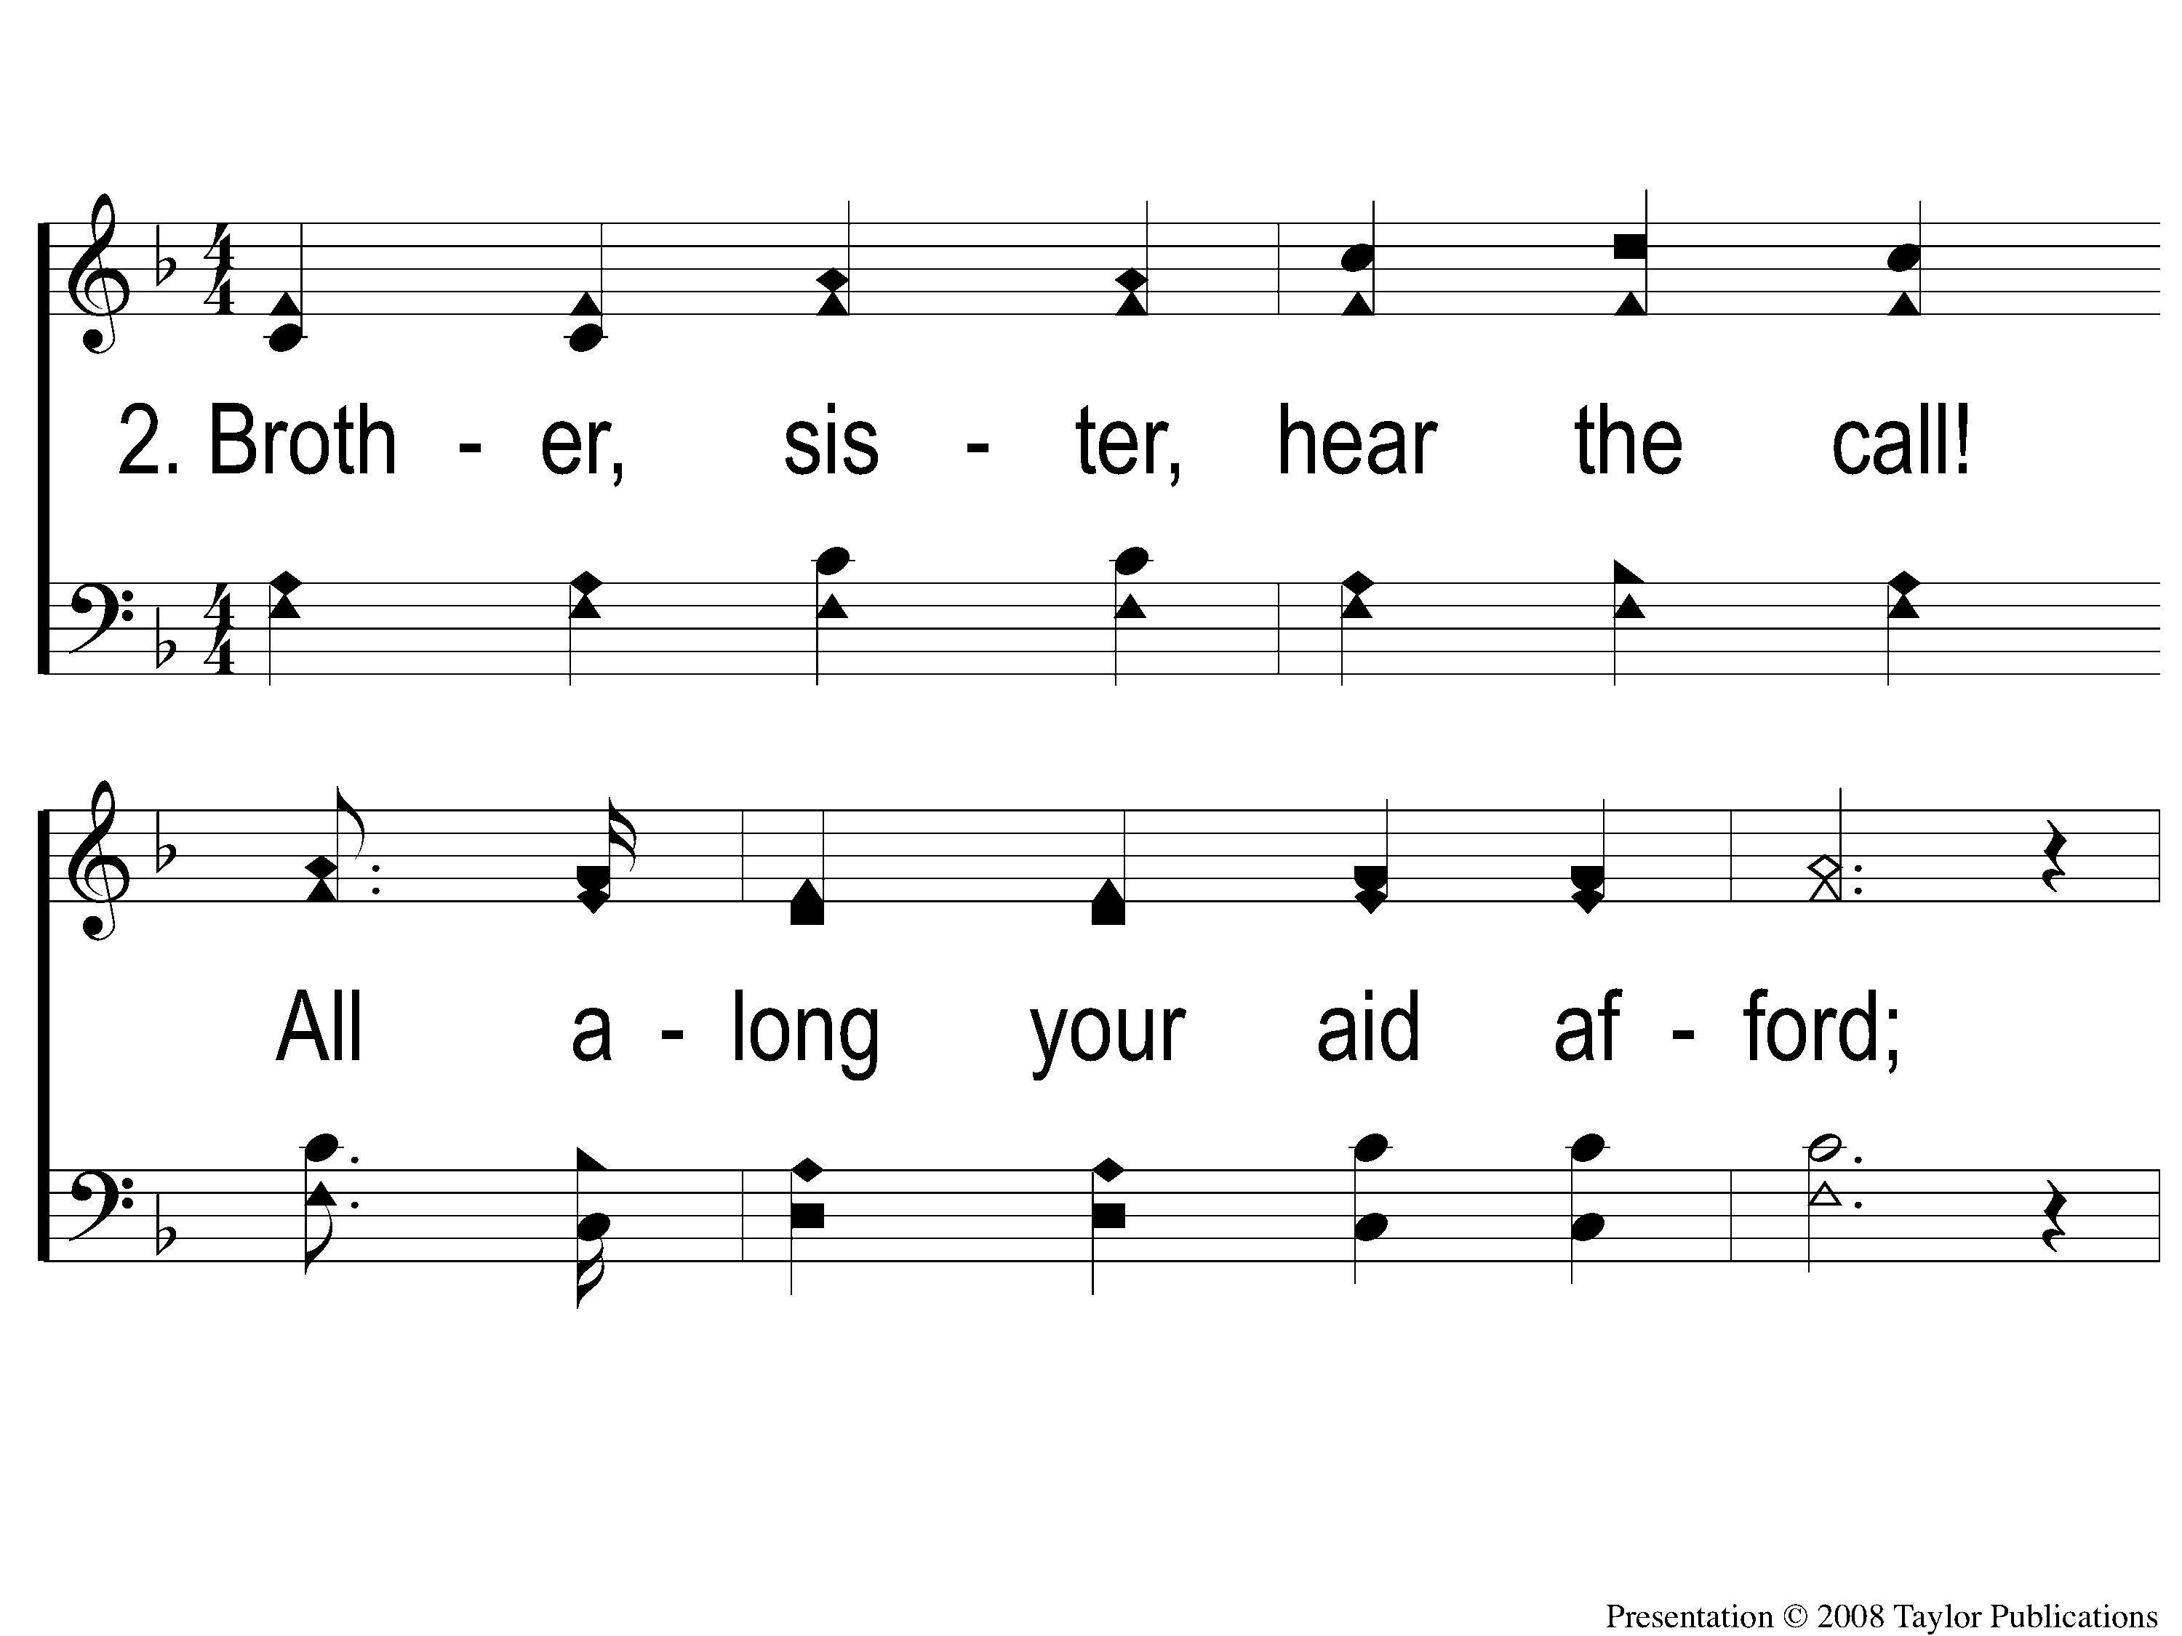
2-1 Call For Workers
Call For Workers
57

Slide 6
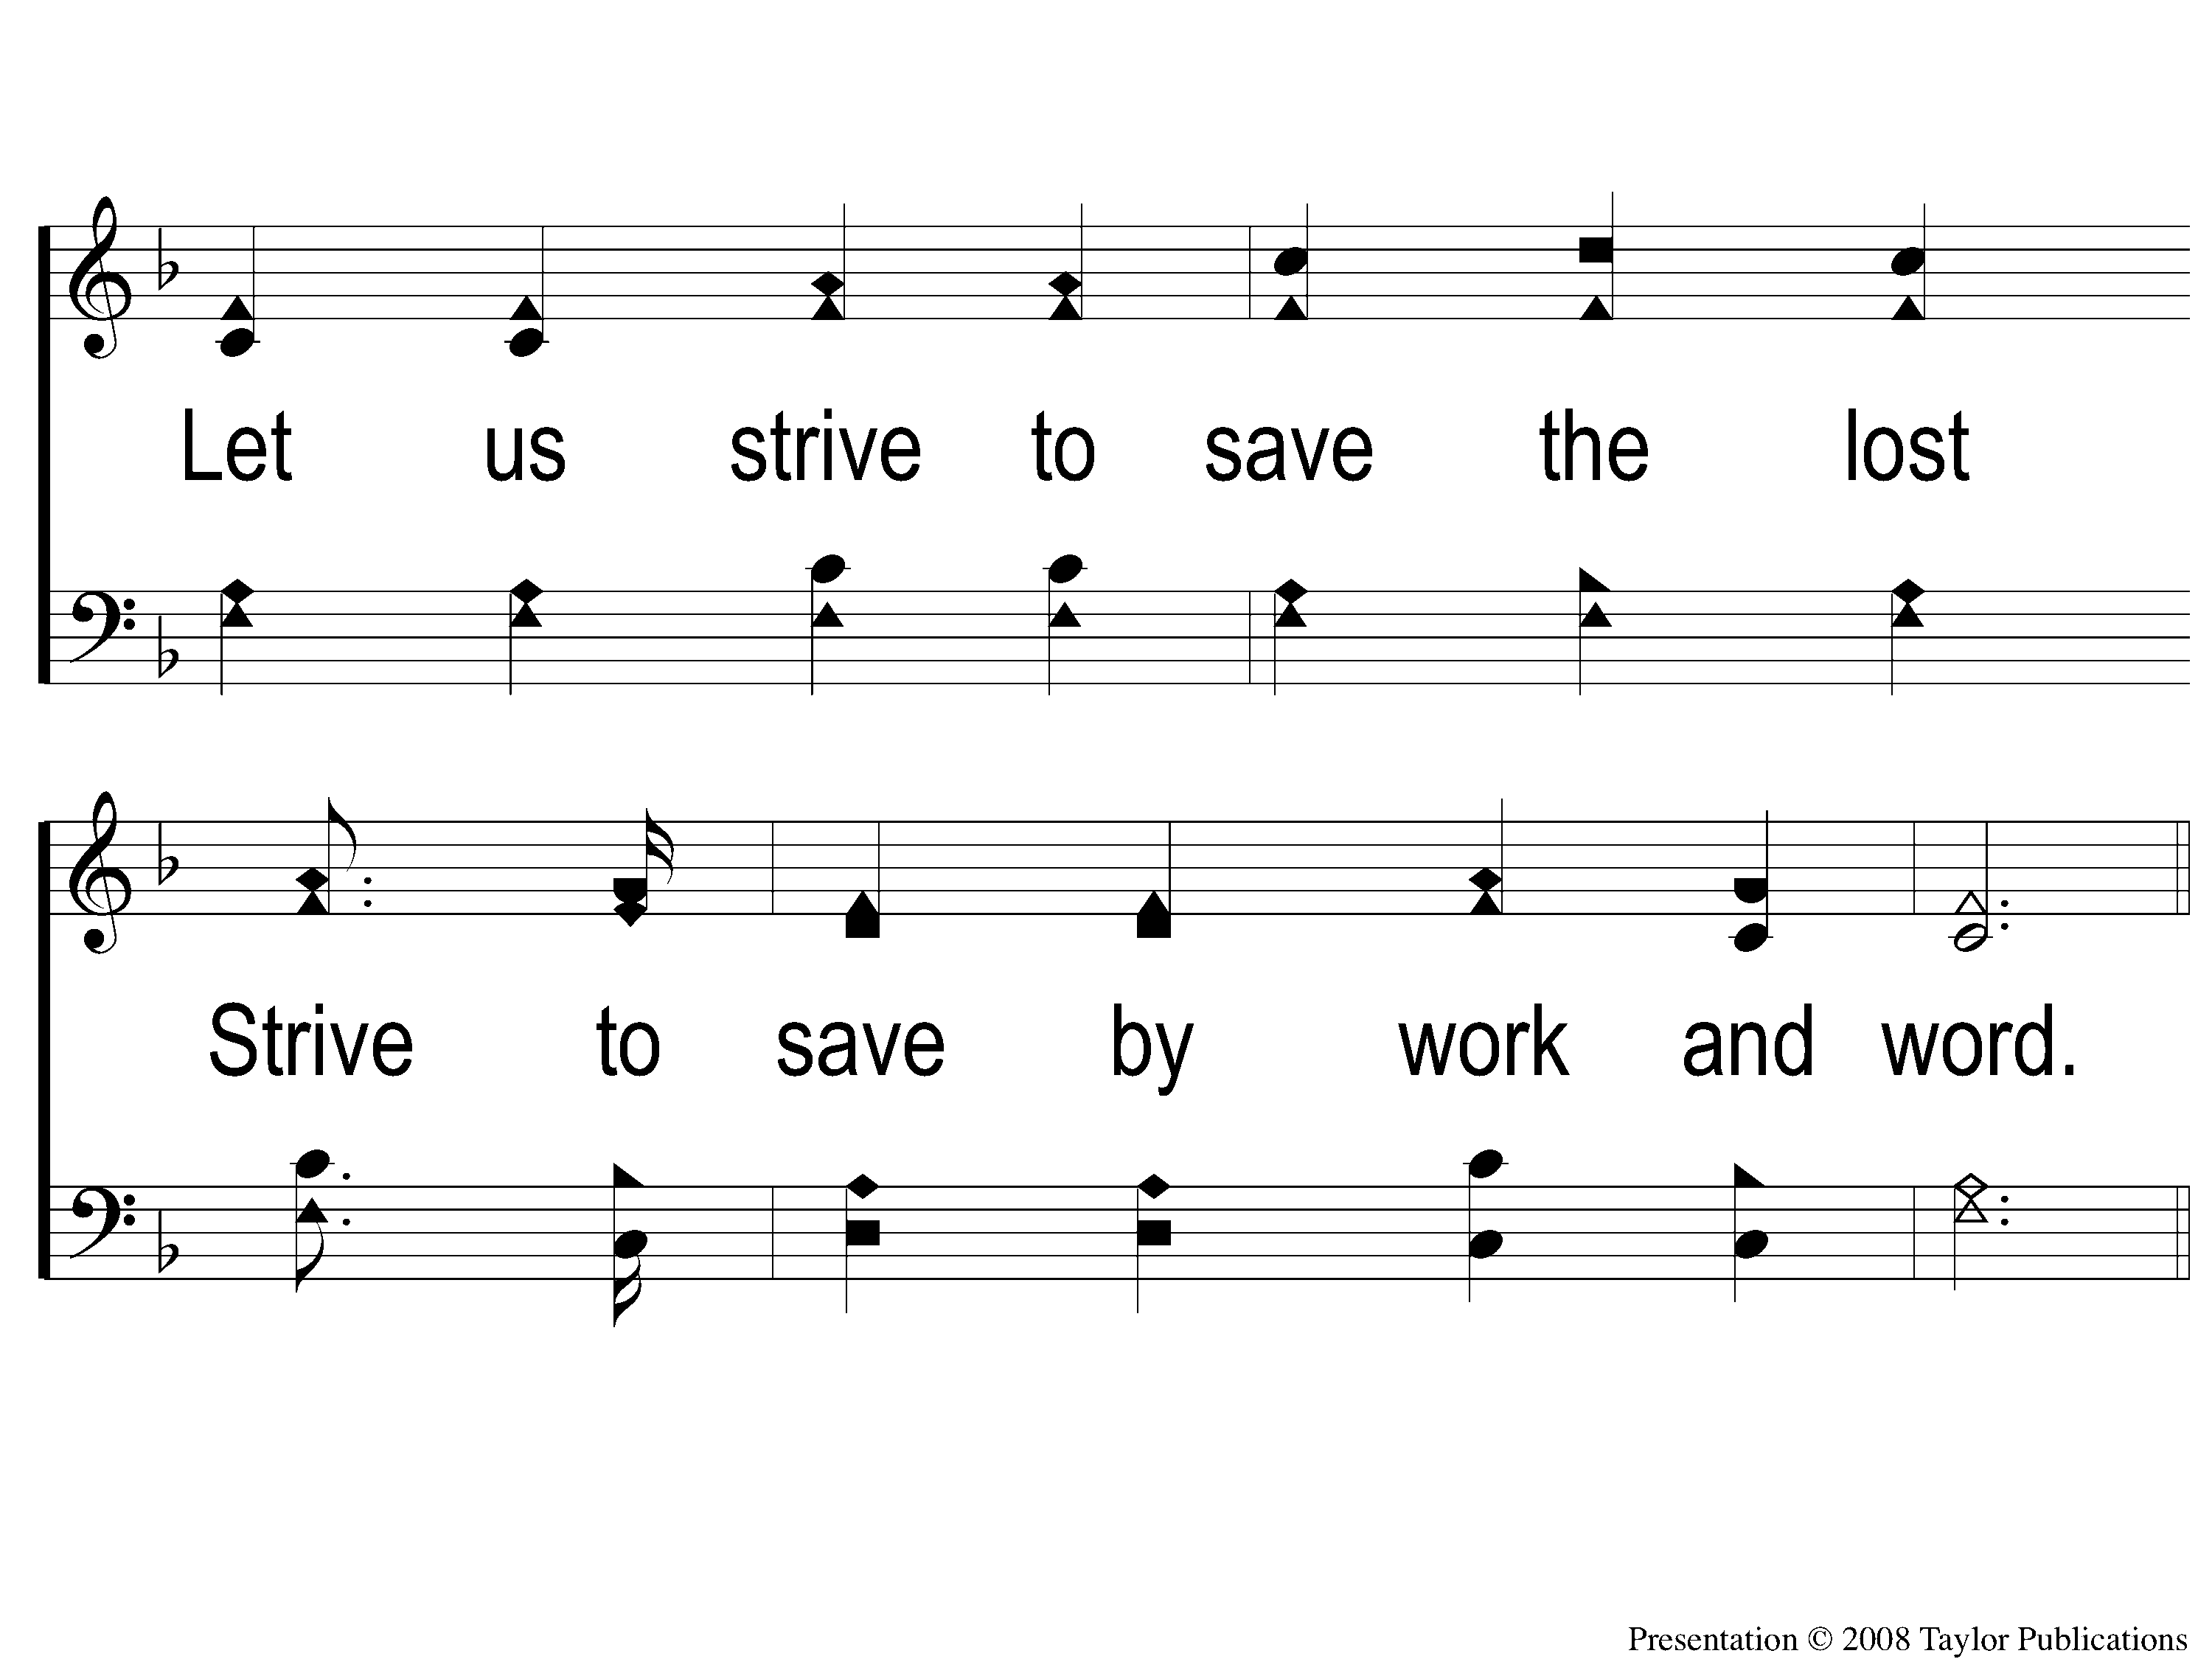
2-2 Call For Workers
Call For Workers
57

Slide 7
C-1 Call For Workers
Call For Workers
57

Slide 8
C-2 Call For Workers
Call For Workers
57

Slide 9
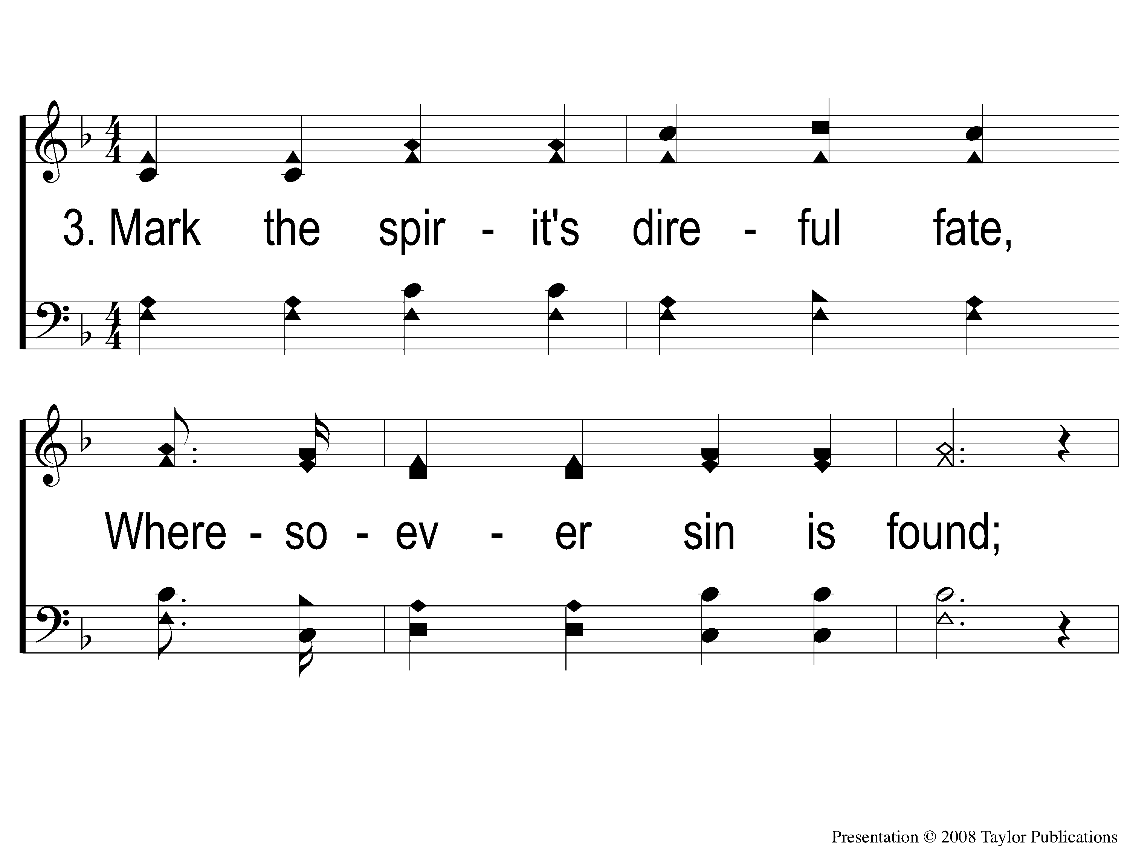
3-1 Call For Workers
Call For Workers
57

Slide 10
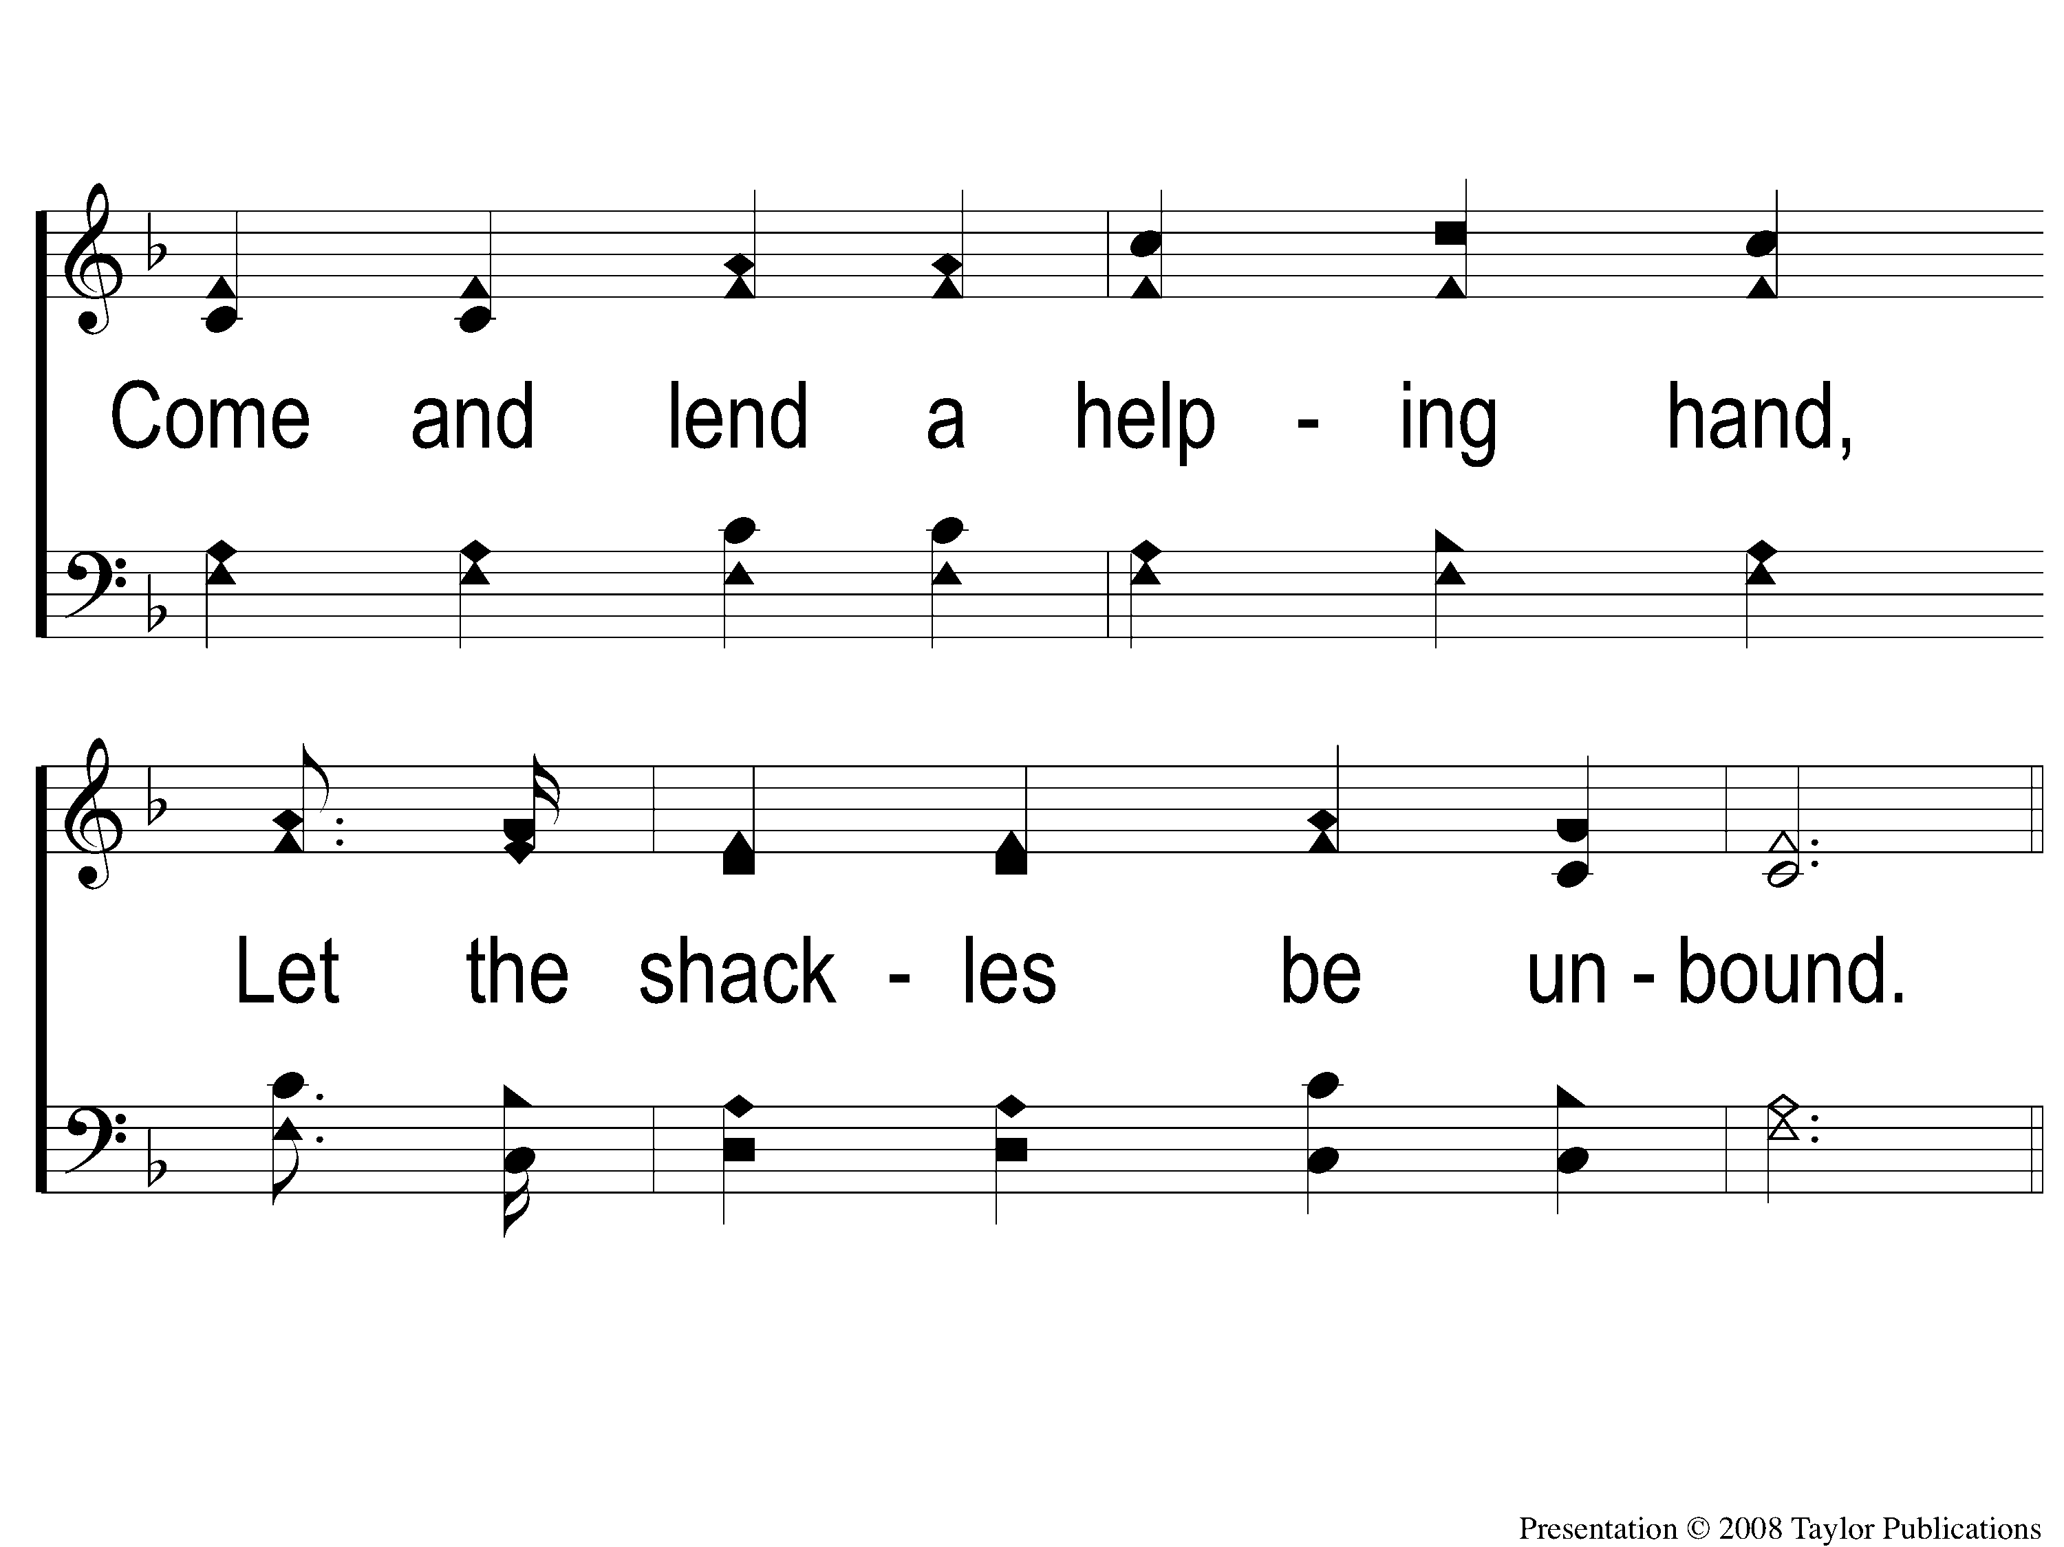
3-2 Call For Workers
Call For Workers
57

Slide 11
C-1 Call For Workers
Call For Workers
57

Slide 12
C-2 Call For Workers
Call For Workers
57

Slide 13
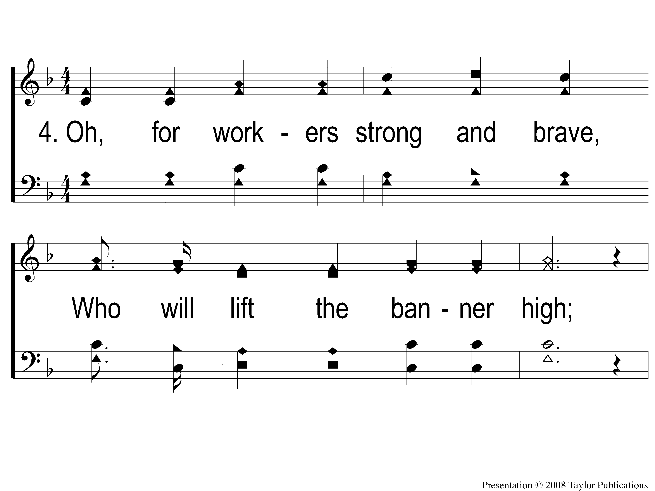
4-1 Call For Workers
Call For Workers
57

Slide 14
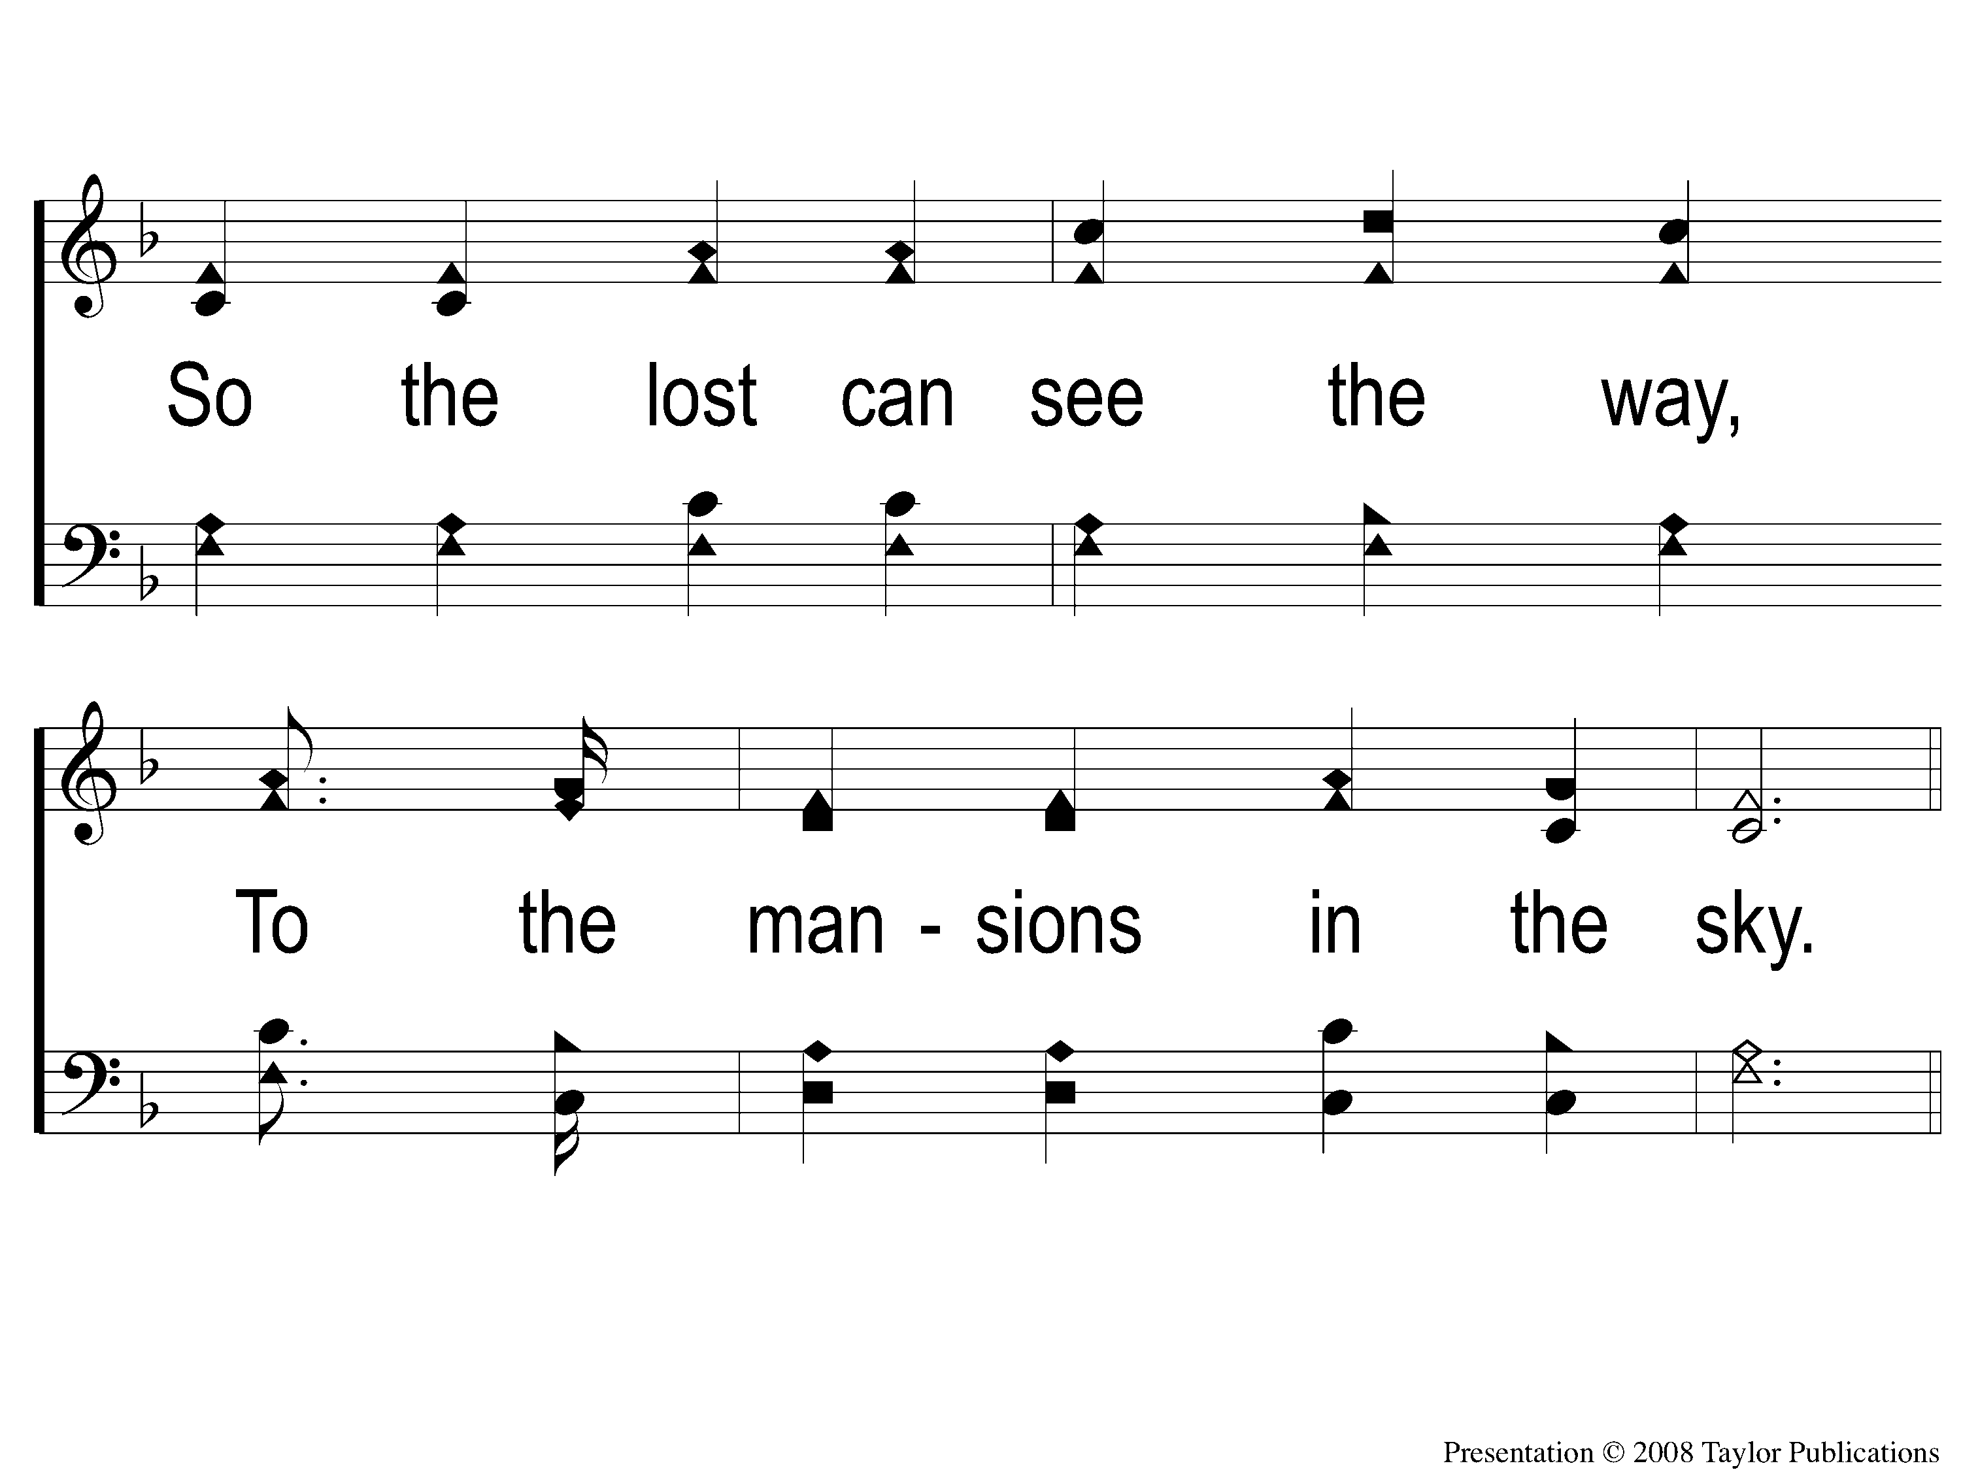
4-2 Call For Workers
Call For Workers
57

Slide 15
C-1 Call For Workers
Call For Workers
57

Slide 16
C-2 Call For Workers
Call For Workers
57

